Slide 1
IS 120
CSS Flexbox

Slide 2
Announcements
HW6 will be posted after class tomorrow
Part of HW6 submission will be a mid-semester survey

Slide 3
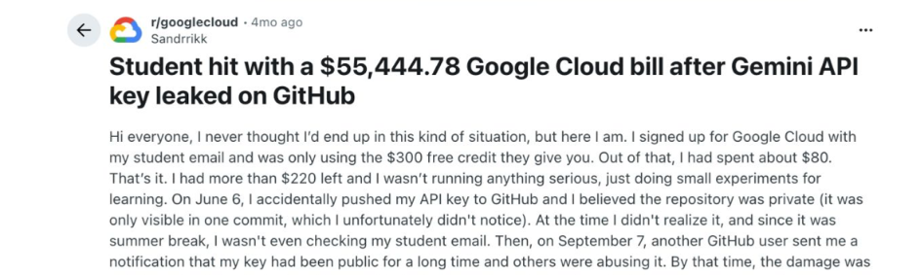
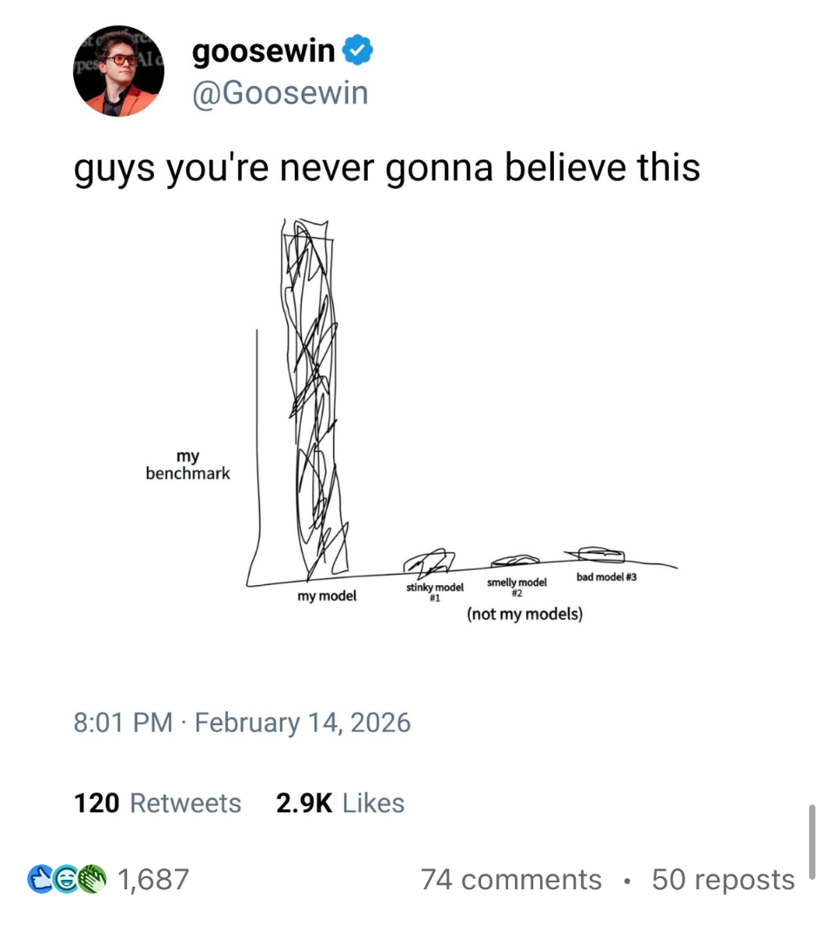


Slide 4
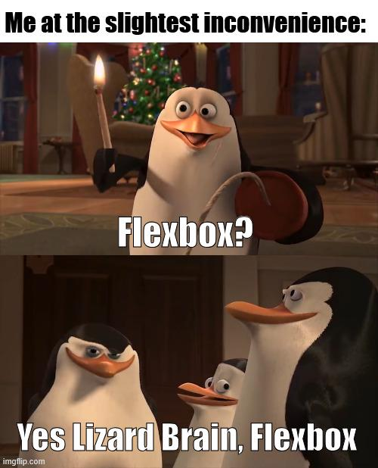


Slide 5
What is Flexbox?
Flexbox -> Flexible Box Layout
A layout model used align items in a container
Flexible and responsive, great for modern web design
Flexbox is used EVERYWHERE
Much easier to use than float and position

Slide 6
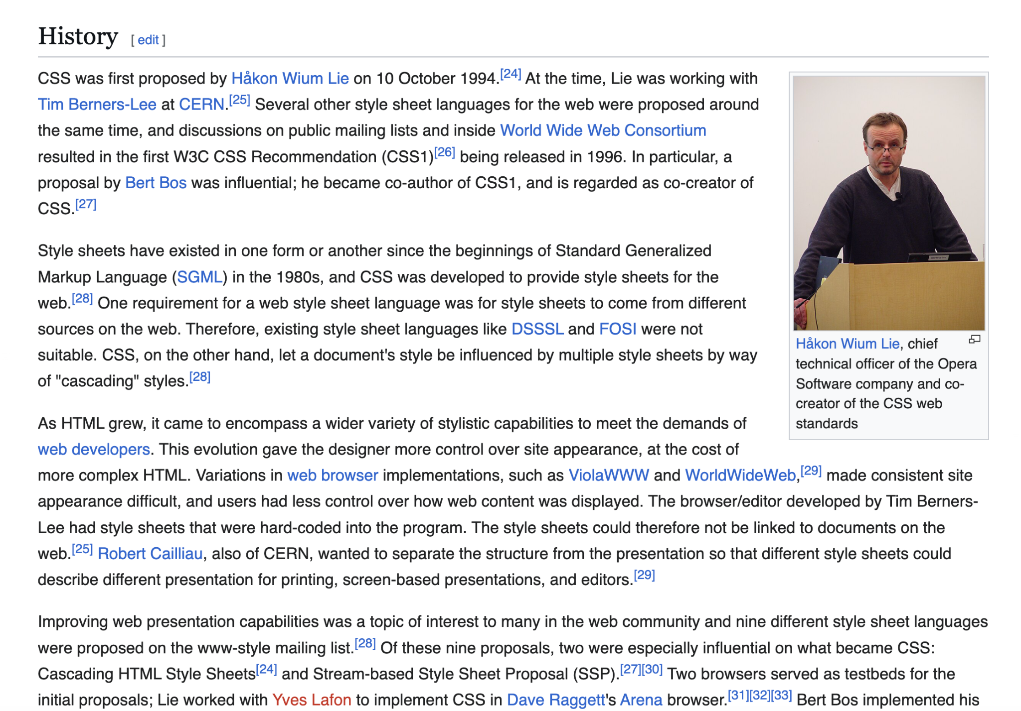
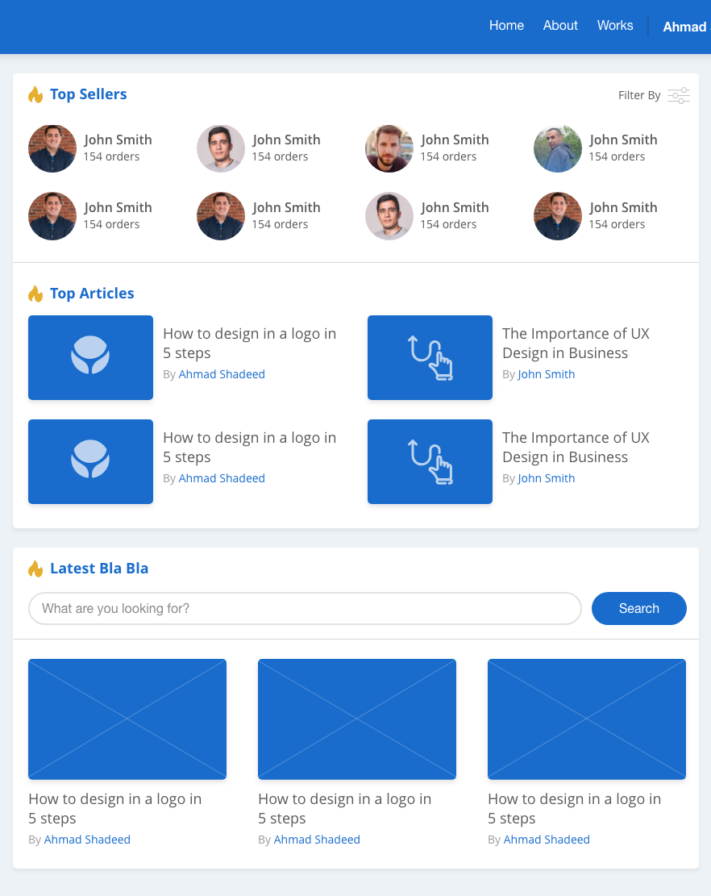
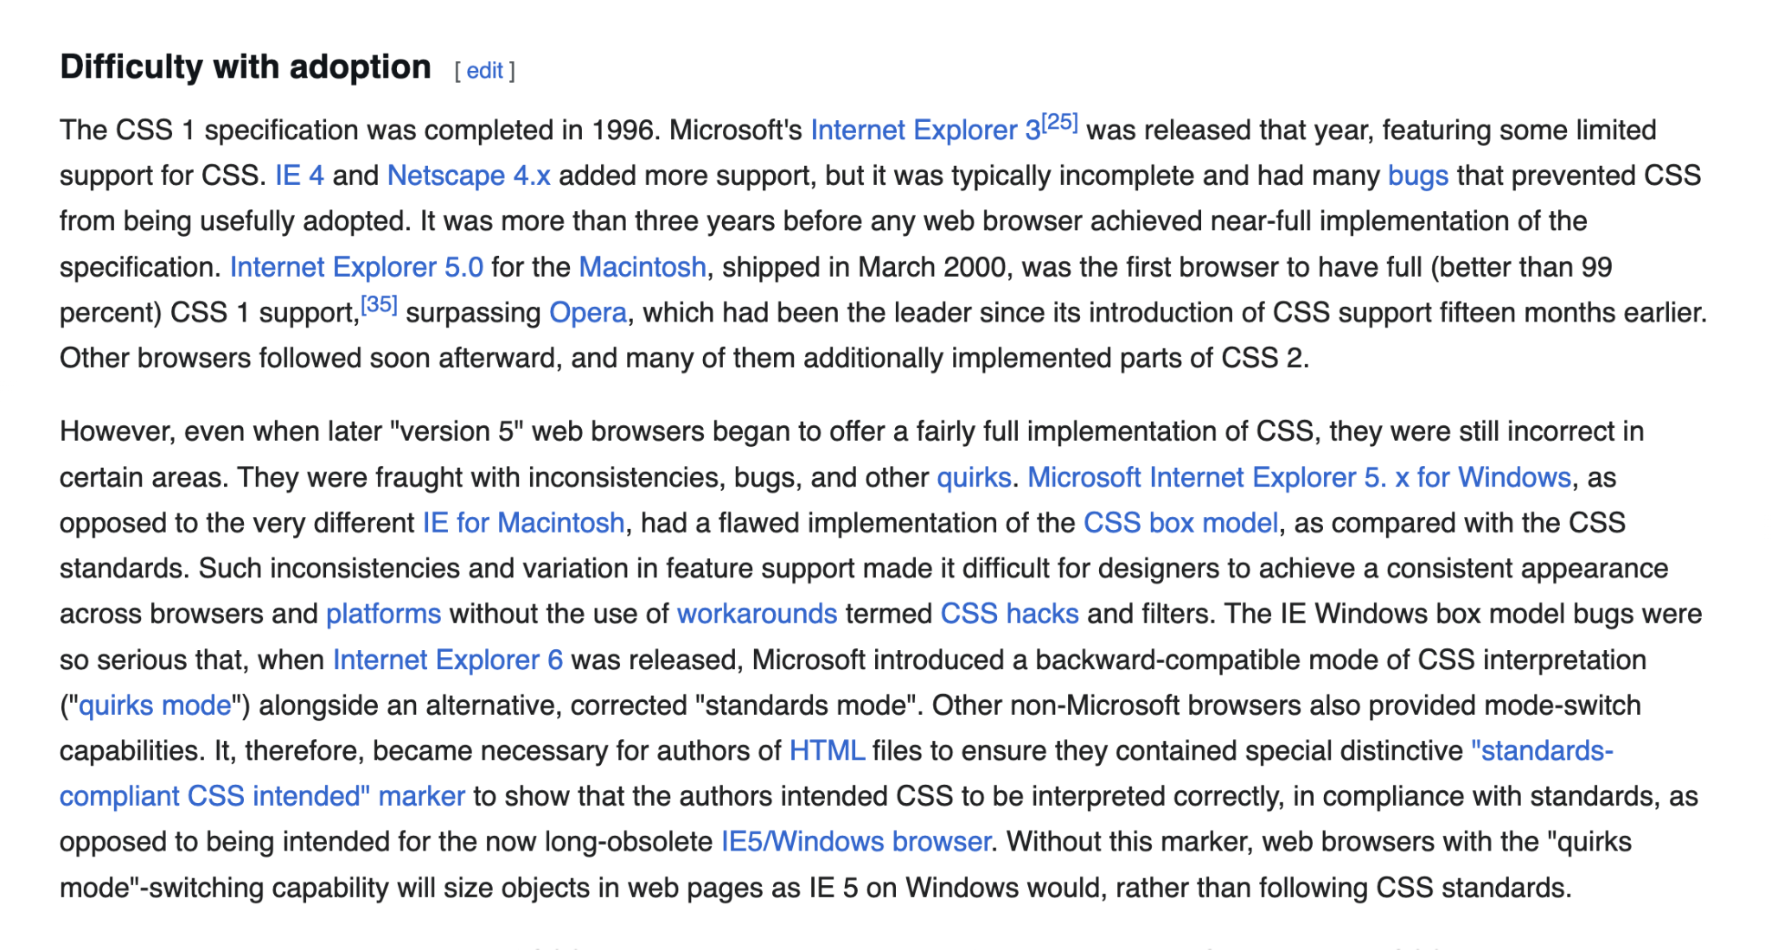

Slide 7
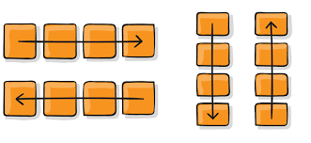
What Does Flexbox Do?
Adds a new “flow” to the document to manipulate elements in a new way
Flexbox allows you to determine the axis for this flow, either in a column or row

Slide 8
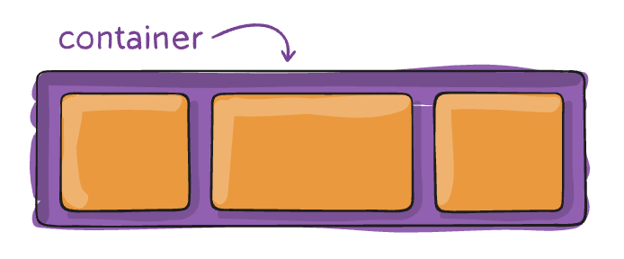
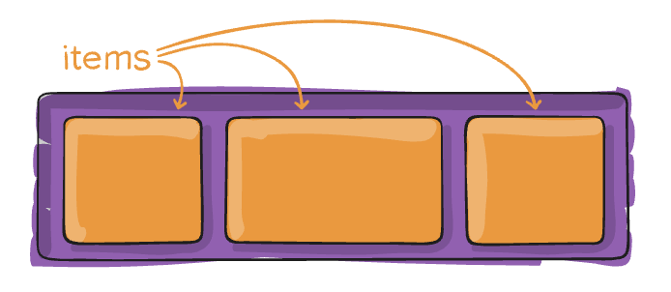
#1 Rule of Flexbox
Flexbox will always have a container and one or more items
Mastering flexbox is understanding the difference between container and item styles

Slide 9
Flexbox Froggy

